Slide 1
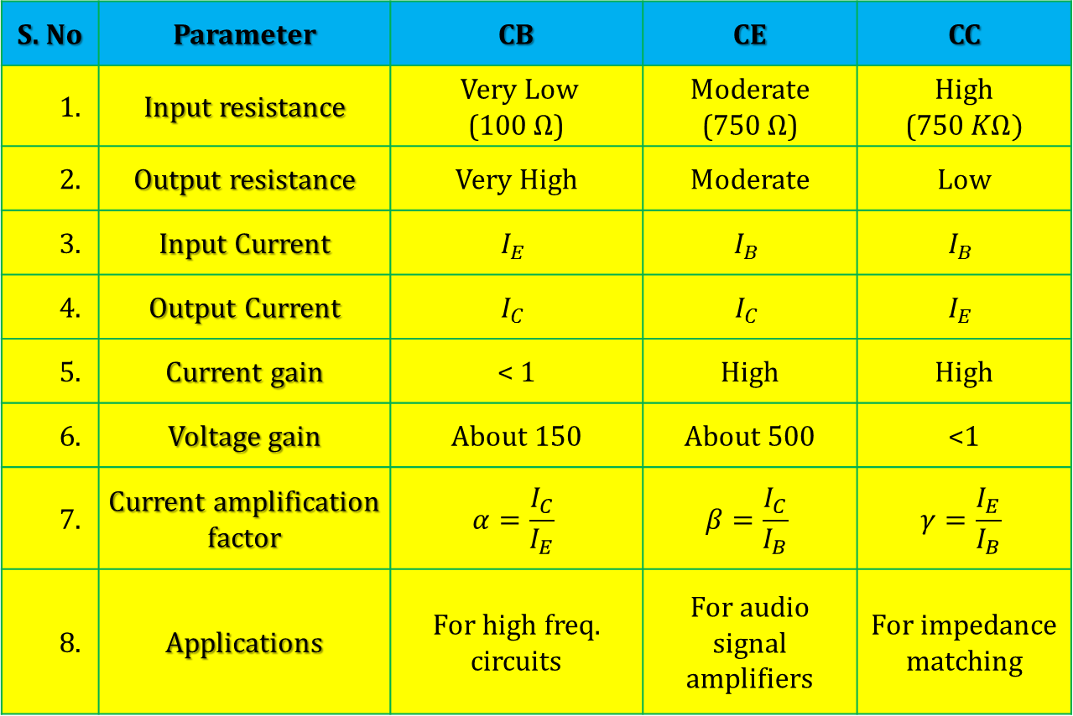
S. No | Parameter | CB | CE | CC
1. | Input resistance | Very Low (100$Ω$) | Moderate (750$Ω$) | High (750$KΩ)$
2. | Output resistance | Very High | Moderate | Low
3. | Input Current | $$I_{E}$$ | $$I_{B}$$ | $$I_{B}$$
4. | Output Current | $$I_{C}$$ | $$I_{C}$$ | $$I_{E}$$
5. | Current gain | < 1 | High | High
6. | Voltage gain | About 150 | About 500 | <1
7. | Current amplification factor | $$α=\frac{I_{C}}{I_{E}}$$ | $$β=\frac{I_{C}}{I_{B}}$$ | $$γ=\frac{I_{E}}{I_{B}}$$
8. | Applications | For high freq. circuits | For audio signal amplifiers | For impedance matching

Slide 2
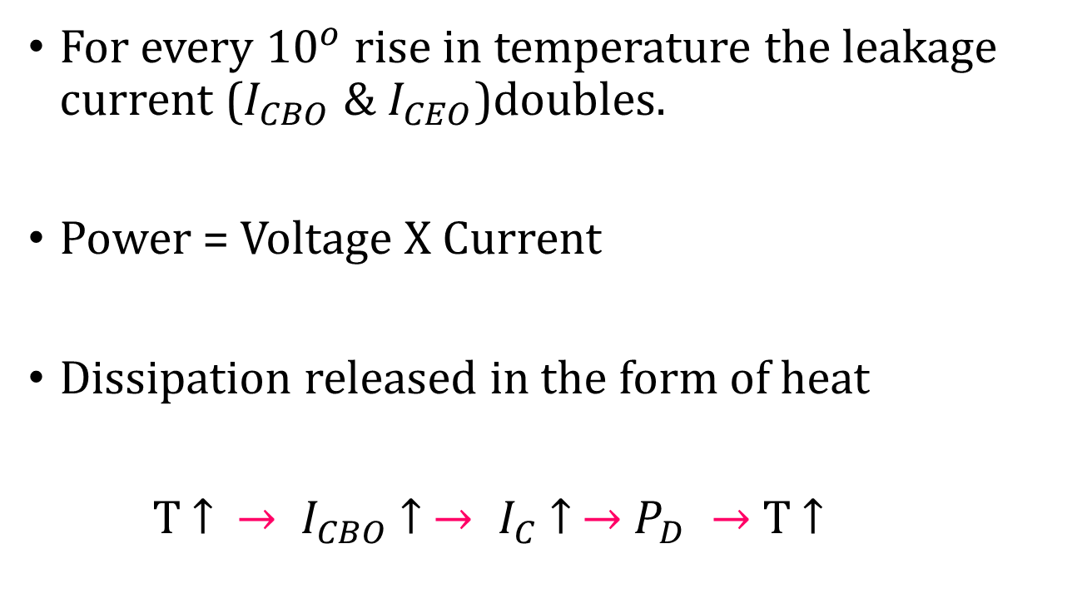
Thermal Runaway
For every ${10}^{o}$ rise in temperature the leakage current ($I_{CBO}$ & $I_{CEO}$)doubles.
Power = Voltage X Current
Dissipation released in the form of heat
T $↑ → I_{CBO}$ $↑$ $→ I_{C}$ $↑$ $→$ $P_{D} →$ T $↑$

Slide 3
Thermal Runaway
$$I_{CBO}$$
𝑰_𝑪𝑩𝑶
$I_{C}$
𝑰_𝑪
$$P_{D}$$
𝑷_𝑫
T

